Slide 1
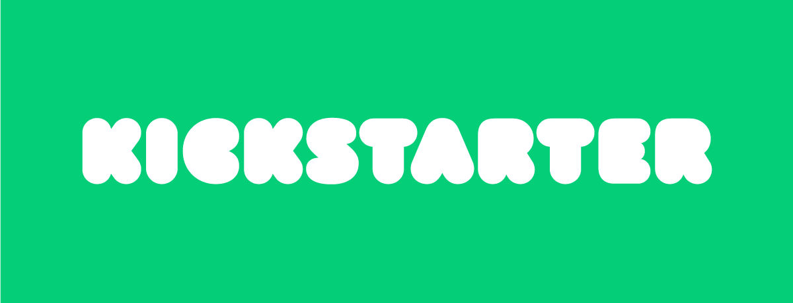

Kickstarter Project Presentation
Presenter: Jake Ehlers
Date: 9/2/20

Slide 2
With over $600 million pledged to Kickstarter projects each recent year, we want to improve a projects chance at succeeding more than the overall success rate of 40%. In order to increase chances of project success, increasing the number of backers with better incentives and having a shorter, more concentrated funding duration would be beneficial.
Projects in the main categories of Dance, Theater, and Comics are around 20% more likely to be successful than the average, while projects in Technology, Journalism, and Crafts are around 20% less likely to be successful than the average.
To no surprise, increasing the number of backers and amount pledged can lead to an easier chance for success, so offering better pledge rewards can help with those chances.
Having a longer project duration is less likely to be successful, projects should look to have a shorter, concentrated funding duration around 30 days.

Slide 3
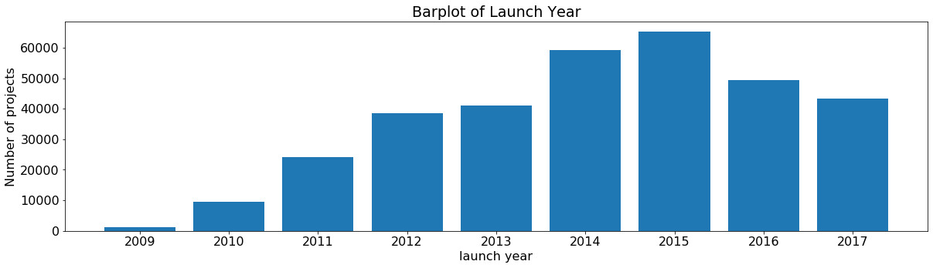
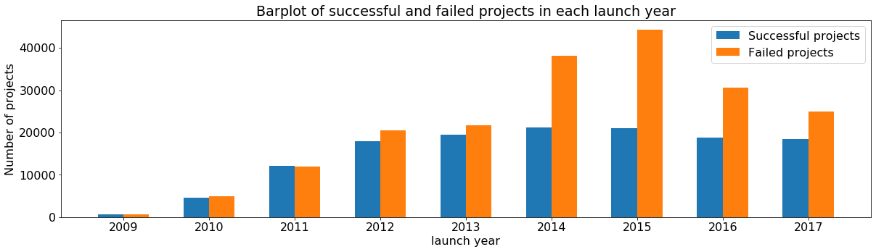
Number of successful projects throughout the years hasn’t varied much, even with the increased competition. With the number of projects decreasing since 2015 the overall success rate is on the rise from 32% to 42%.

Slide 4
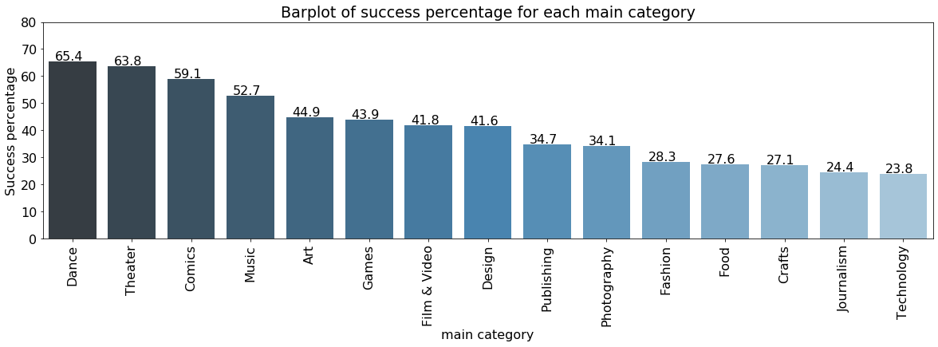
With an overall project success rate of 40%, we can see that Dance and Theater outperform the average in success percentage while Technology and Journalism make up the worst success percentages.

Slide 5
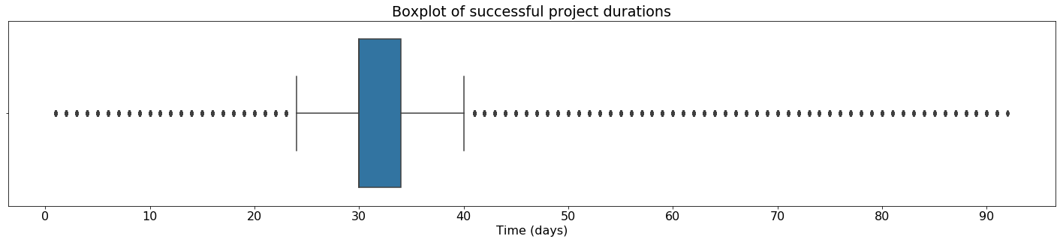
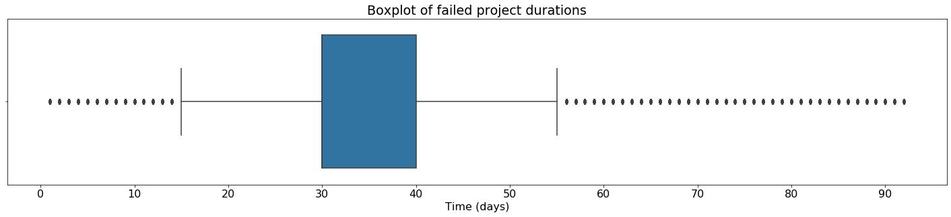
While there is a temptation to extend funding duration to be longer, keeping funding duration between 30-35 days and focusing funding efforts to that time would be better to improve chances of success.

Slide 6
When looking to fund a project through Kickstarter, keeping funding duration to 30-35 days and offering better incentives to increase number of backers can improve chances of success.
Depending on which main category a product is in, looking at the overall success rate can give a good idea on expectations of success. Notably, projects in Dance, Theater, and Comics tend to succeed around 60% of the time.
As discussed before, planning a funding duration between 30-35 days can help improve chances of success.

